Slide 1
A Study Of
The Book Of Revelation
March 7, 2021

Slide 2
Resources used:
A Study Of The Book Of Revelation by Bob Dodson
More Than Conquerors by William Hendriksen
Overcoming With The Lamb, Florida College Annual Lectures, February 7-10, 1994
Revelation: An Introduction and Commentary by Homer Hailey
Revelation (Truth Commentaries) by Robert Harkrider
Revelation (A Study Workbook) by Robert Harkrider
Revelation by Donnie Rader
Revelation charts by Keith Greer.
Studies In The Book Of Revelation by Ferrell Jenkins
The Old Testament In The Book Of Revelation by Ferrell Jenkins
The Revelation Of Saint John The Divine by G.B. Caird
The Book of Revelation by Foy E. Wallace
The Avenging of the Apostles and Prophets by Arthur M. Ogden
Worthy Is The Lamb by Ray Summers
Written exchange on “The Domitian Persecution” between Arthur M. Ogden and Ferrell Jenkins presented in Searching The Scriptures, June 12, 1989, pages 7-12

Slide 3
Revelation
II. Christ And The Dragon In Conflict (12-22)
(Deeper Spiritual Meaning)
A. War (12-14)
B. Bowls of Wrath (15-16)
C. Fall of Babylon the Harlot (17-18)
D. Victory of God’s people (19-21)
E. Warnings about the Book (22)

Slide 4
Revelation 14
1-11
Victory
from the
vantage point
of the
Christian / Earth
12-22
Victory
from the
vantage point
of
God / Heaven

Slide 5
Revelation 14
“The Victorious Lamb”
Outline
The Lamb and 144,000 on Mt. Zion (verses 1-5)
Messages from Heaven (verses 6-13)
Harvest Time (verses 14-20)

Slide 6
Revelation 14
What Is The Point?
Victory and Judgment
Chapter 12 – It’s all a battle With Satan
Chapter 13 – Rome (ally of Satan) Fail!
– Paganism, False Prophet
Chapter 14 – God and His people – Victory

Slide 7
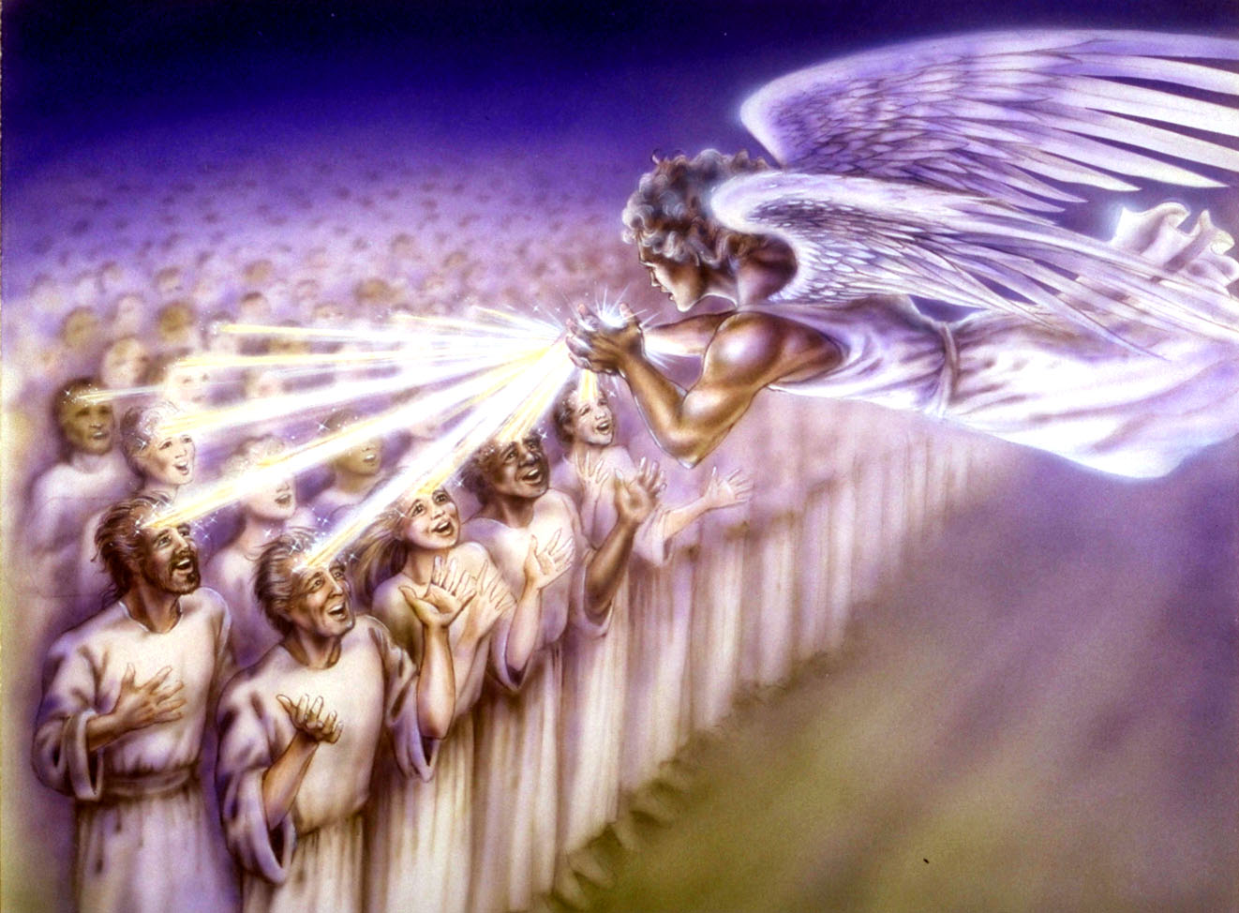
Book of Revelation:
Chapter 14
Revelation 14
Christ and His Righteous Forces

Slide 8

Revelation 14:1
Revelation 14
“And I saw, and behold, the Lamb standing on the mount Zion, and with him a hundred and forty and four thousand, having his name, and the name of his Father, written on their foreheads.”

Slide 9
The Lamb and His Own
Revelation 14
The Lamb
  Victorious Christ of Chapter 5
Standing on Mount Zion
  Heavenly Jerusalem (Psalms 125:1; Hebrews 12:22-23)
144,000
  (7:1-8) sealed by God for their faithfulness
His name
  Name carries power (Acts 4:12; Philippians 2:9-11)
His Father’s name written on their foreheads
  John 14:6; Revelation 13:16

Slide 10
Revelation 14
144,000
Not Literal
  Seal is not a literal seal (chapter 7)
  Four corners are not literal corners (chapter 7)
  Of twelve tribes (chapter 7)
  Virgins (chapter 14)
  If already have 144,000 – cannot be 144,001!
It Is The Idea of Completeness
  12 X 12 (Religious number) Multiplied X 1000
  Absolute completeness
  Not one of the faithful will be lost!

Slide 11
Revelation 14:2
Revelation 14
“And I heard a voice from heaven, as the voice of many waters, and as the voice of a great thunder: and the voice which I heard (was) as (the voice) of harpers harping with their harps”

Slide 12
A Voice …
Revelation 14
A voice “from heaven” LIKE the sound of:
  “Many waters” (1:15)
  “Loud thunder” (6:1)
  “Harpists,” not only loud but melodious and attractive.
  Remember, this is figurative language

Slide 13
Revelation 14:3
Revelation 14
“and they sing as it were a new song before the throne, and before the four living creatures and the elders: and no man could learn the song save the hundred and forty and four thousand, (even) they that had been purchased out of the earth.”

Slide 14
The New Song
Revelation 14
They were singing a “new song”
  “Before the throne”
  “Before the four living creatures”
  “Before the elders”
“No one could learn the song except the 144,000”
  Only those who had been purchased with, and received redemption in, Christ’s blood! (Rev. 1:5; 5:9)

Slide 15
Revelation 14:4
Revelation 14
“These are they that were not defiled with women; for they are virgins. These (are) they that follow the Lamb whithersoever he goeth. These were purchased from among men, (to be) the firstfruits unto God and unto the Lamb.”

Slide 16
Revelation 14:5
Revelation 14
“And in their mouth was found no lie: they are without blemish.”

Slide 17
A Description of the 144,000
Revelation 14
The 144,000 (Ephesians 1:13-14)
  Have names (Father/Son) upon them
  “Were not defiled with women” (righteous individuals) (2 Corinthians 11:2; 1 Corinthians 6:20; Ephesians 5:11ff)
  “Who follow the Lamb wherever He goes”
  (1 Corinthians 11:1; 1 Peter 2:21-22)
  “Redeemed from among men” (from the earth)
  (Acts 20:28; 1 Peter 1:18)

Slide 18
A Description of the 144,000
Revelation 14
The 144,000 (Ephesians 1:13-14)
  “First fruits to God and to the Lamb” (James 1:18) figure of harvest acceptable to God – separated for His use (14:14-16)
  “Free from deceit” without blemish – Christ is Lord! (Colossians 1:22; Ephesians 5:26-27; Jude 24-25)

Slide 19
Coming Attractions …
Revelation 14
Six great proclamations …
Four “headline banners”
Two “videos of the sickle of Judgment”
Preview of what God is going to do…
God knows what He is going to do; He “rules in the kingdoms of man!”
  Revelation 14:6-20 …

Slide 20
Revelation 14:6
Revelation 14
“And I saw another angel flying in mid heaven, having eternal good tidings to proclaim unto them that dwell on the earth, and unto every nation and tribe and tongue and people”
The Gospel

Slide 21
Revelation 14:7
Revelation 14
“and he saith with a great voice, Fear God, and give him glory; for the hour of his judgment is come: and worship him that made the heaven and the earth and sea and fountains of waters.”

Slide 22
Banner Number 1 …
Revelation 14
Triumph of Righteousness
Eternal Good News – Chapters 15-16
Brought by “another angel” to differentiate from those mentioned earlier
  “Flying in the midst of heaven”
  “Having an eternal gospel to preach to those living on earth”
    Judgment – Romans 2:16
    Repentance – Acts 14:15

Slide 23
Banner Number 1 …
Revelation 14
Triumph of Righteousness
Eternal Good News – Chapters 15-16
Proclaimed …
  “Fear God”
  He is Creator of all the earth.
  “Worship Him”
  “For the hour of His judgment has come.”
    John 3:18-19

Slide 24
Banner Number 1…
Revelation 14
Triumph of Righteousness
Eternal Good News – Chapters 15-16
God’s purposes will not be defeated!
God will not allow His righteous children to be trampled on indefinitely!
Sinners will perish, and righteousness will triumph – rejoice!
God’s wrath is as holy as His love.
There’ll always be consequences for ungodliness.

Slide 25
Banner Number 2 …
Revelation 14
Judgment of Wicked Babylon
Consequences – More in Chapters 17,18
  Old Testament Babylon was a place of arrogance and rebellion against God.
  NOTE: Isaiah 13:17-22; 21:9; 47:5-9; 48:14; Jeremiah 50:32, 38; 51:7-8
It was so wicked God overthrew it completely; it was never rebuilt.
Repetition for tragic emphasis (prophetic)

